Slide 1

Vidya Vikas Education Trust’s Universal College of Engineering, Kaman Road, Vasai-401212 Aproved by AICTE, DTE and affiliated to the University of Mumbai
Department of Information Technology
University of Mumbai
(AY 2021-22)
-Dr. Yogita Mane

Slide 2
CAFE DELIGHT
S.E. mini-project report submitted in partial fulfilment of the requirements of the degree of
Information Technology
by
ANSARI MOHAMMAD RAFEY (01)
ROSHAN ASHOK LIMBANI (31)
SUMIT KUMAR SINGH (57)
HARSHIKESH RAJENDRA YADAV (67)
Under the guidance of
Dr. YOGITA MANE
(HOD)
-Dr. Yogita Mane

Slide 3
CERTIFICATE
This is to certify that the S.E. mini-project entitled “Cafe Delight” is a bonafide work of “Ansari Mohammad Rafey” (01), “Roshan Ashok Limbani” (31), and “Sumit Kumar Singh”(57) and “Harshikesh Rajendra Yadav”(67) submitted to
University of Mumbai in partial fulfilment of the requirement for the award of the degree of “Information Technology Engineering” during the academic year 2021–2022.
Under the guidance of
Dr. YOGITA MANE
Dr. Yogita Mane Dr. J.B.Patil
(HOD) (Principal)
-Dr. Yogita Mane

Slide 4
S.E. Mini-Project Report Approval
This mini-project synopsis entitled Cafe Delight by Ansari Mohammad Rafey, Roshan Ashok Limbani, Sumit Kumar Singh, Harshikesh Rajendra Yadav is approved for the degree of Information Technology Engineering from University of Mumbai.
Examiners
1.---------------------------------------------
2.---------------------------------------------
Date: Place:
Place :
-Dr. Yogita Mane

Slide 5
Declaration
We declare that this written submission represents our ideas in our own words and where others’ ideas or words have been included, we have adequately cited and referenced the original sources. We also declare that we have adhered to all principles of academic honesty and integrity and have not misrepresented or fabricated or falsified any idea/data/fact/source in our submission. We understand that any violation of the above will be cause for disciplinary action by the Institute and can also evoke penal action from the sources which have thus not been properly cited or from whom proper permission has not been taken when needed.
-Dr. Yogita Mane

Slide 6
PYTHON MINI PROJECT
-Dr. Yogita Mane

Slide 7
TABLE OF CONTENTS
Group Details | Group members name
01 | Introduction
02 | Source Code
03 | Working
-Dr. Yogita Mane

Slide 8

Mini Project Group Members
PRESENTED BY Roll No
Ansari Mohammad Rafey
01
Roshan Ashok Limbani
31
Sumit Kumar Singh
57
67
Harshikesh Rajendra Yadav
-Dr. Yogita Mane

Slide 9
INTRODUCTION
On
CAFÉ DELIGHT
-Dr. Yogita Mane

Slide 10
A coffee shop has always been more than a place to have a beverage. It is a place to socialize, ideate, have fun and meet new people. As Starbucks puts it, it’s the third place, a home away from home or office. Also, due to the competitive and busy lifestyles that people lead today, a coffee house near their work or home has become a major point of relaxation. Café Delight has created a software for all the coffee lover, so if they can’t come to café then they can order online and get delivered to their Home
-Dr. Yogita Mane

Slide 11
SOURCE CODE
-Dr. Yogita Mane

Slide 12
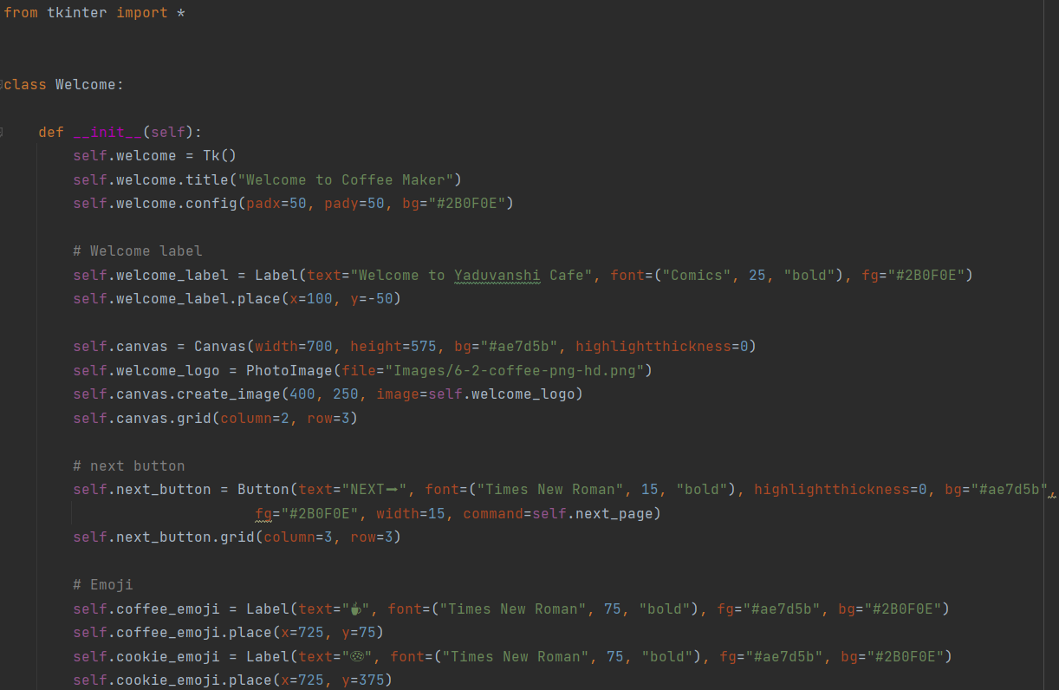
Welcome Page Mechanism
-Dr. Yogita Mane

Slide 13
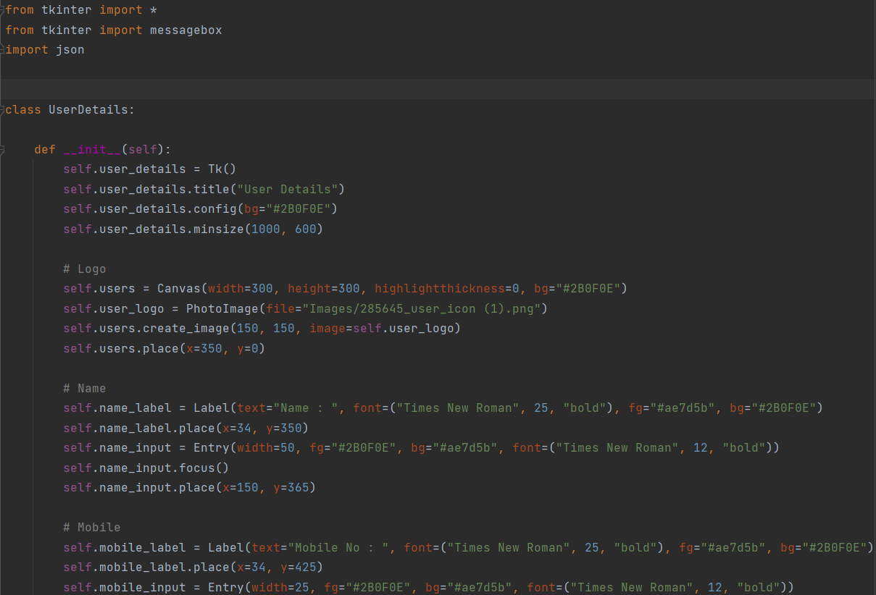
User’s Data Mechanism
-Dr. Yogita Mane

Slide 14
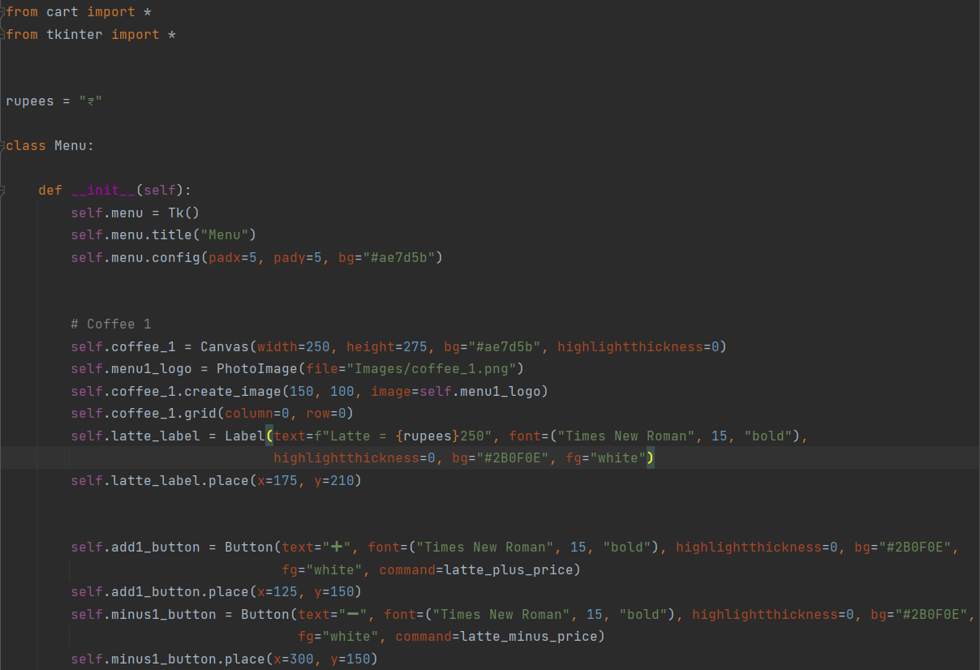
Menu Page Mechanism
-Dr. Yogita Mane

Slide 15
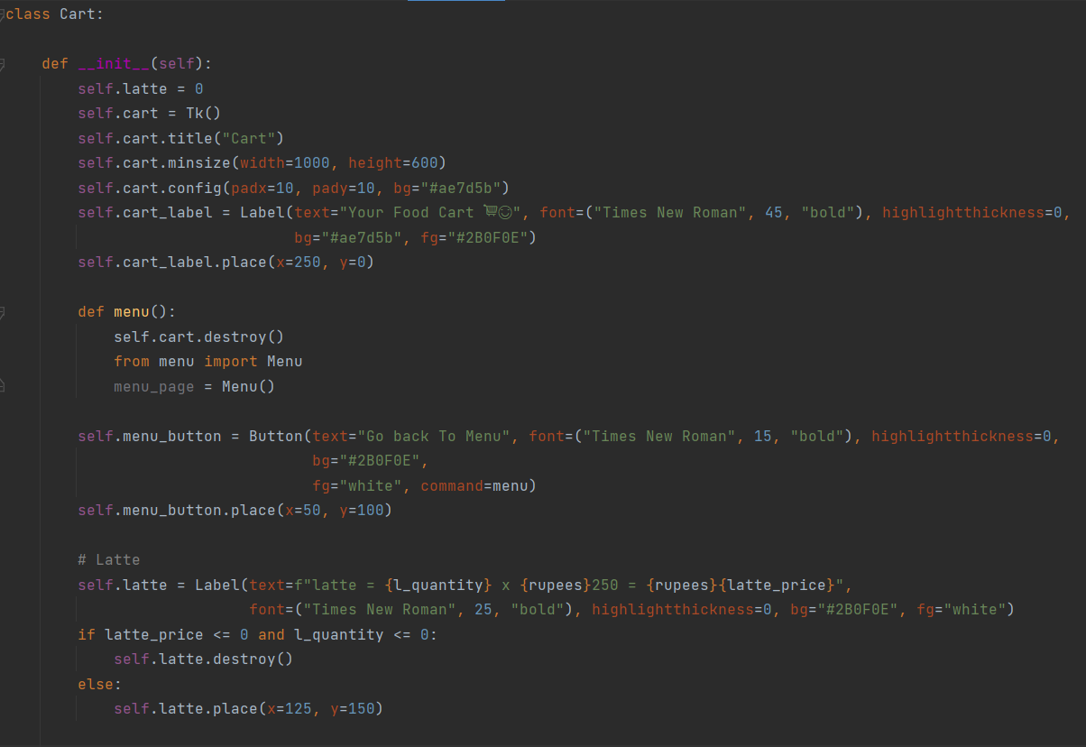
Cart Page Mechanism
-Dr. Yogita Mane

Slide 16
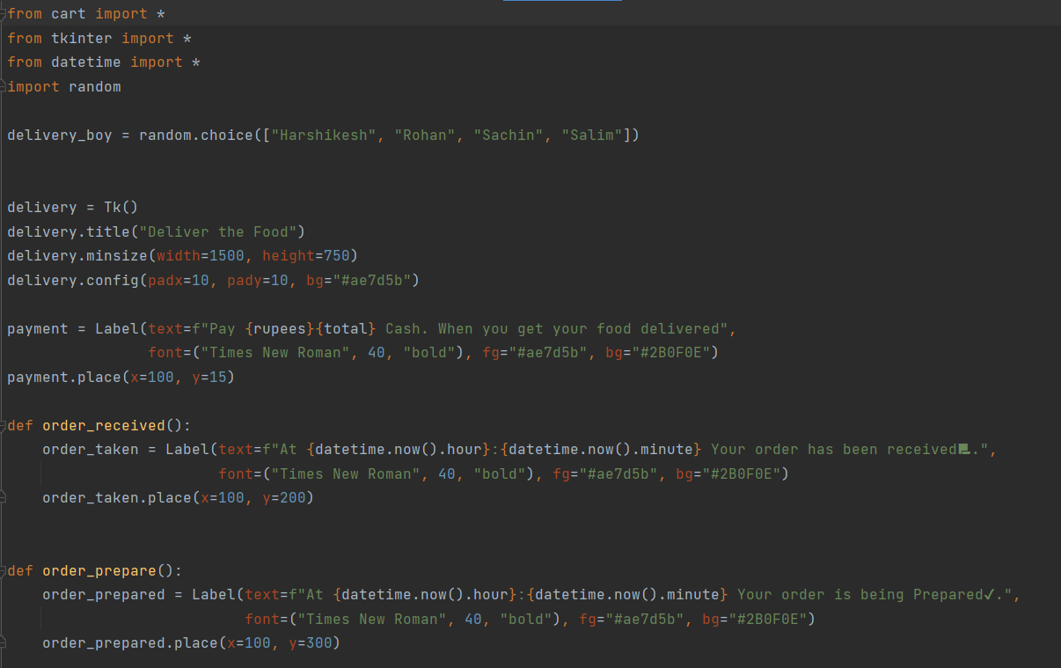
Delivery Page Mechanism
-Dr. Yogita Mane

Slide 17
WORKING
-Dr. Yogita Mane

Slide 18
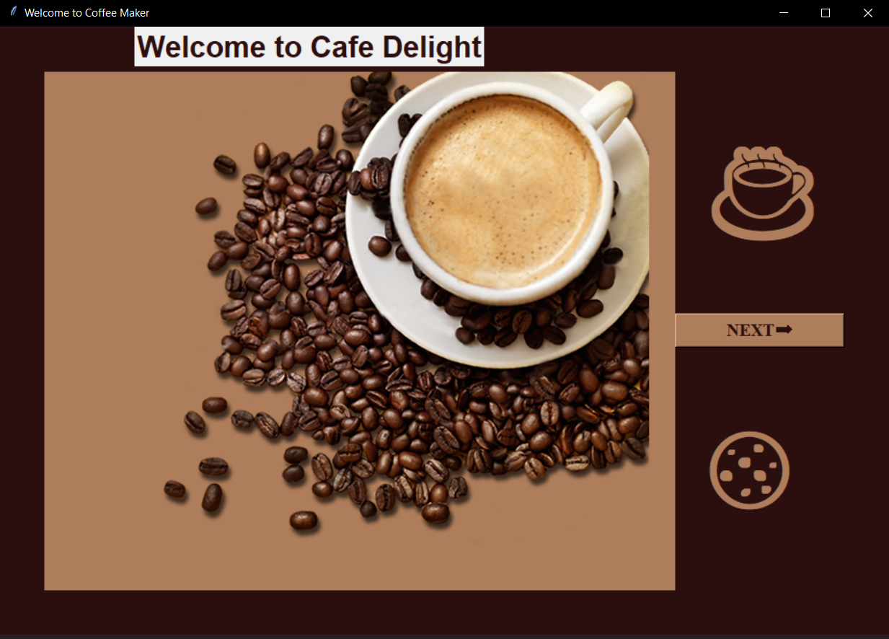
Welcome Page has been created
-Dr. Yogita Mane

Slide 19
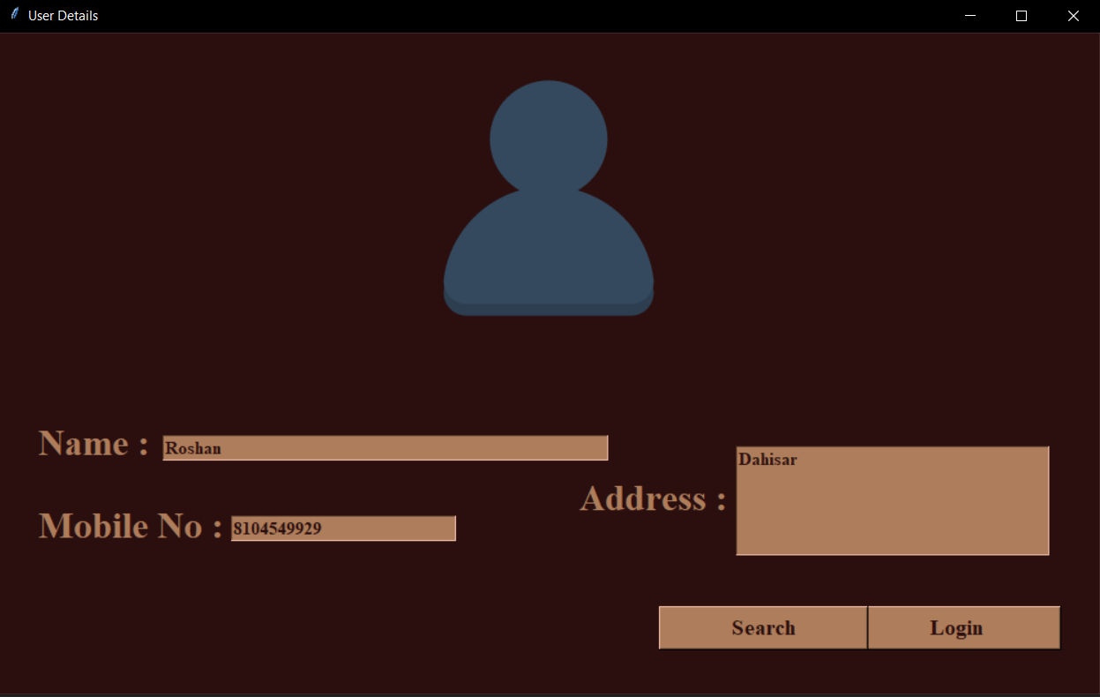
After greeting the user, he/she need to login in to the app. If the user is existing then he can search his data by his phone no.
-Dr. Yogita Mane

Slide 20
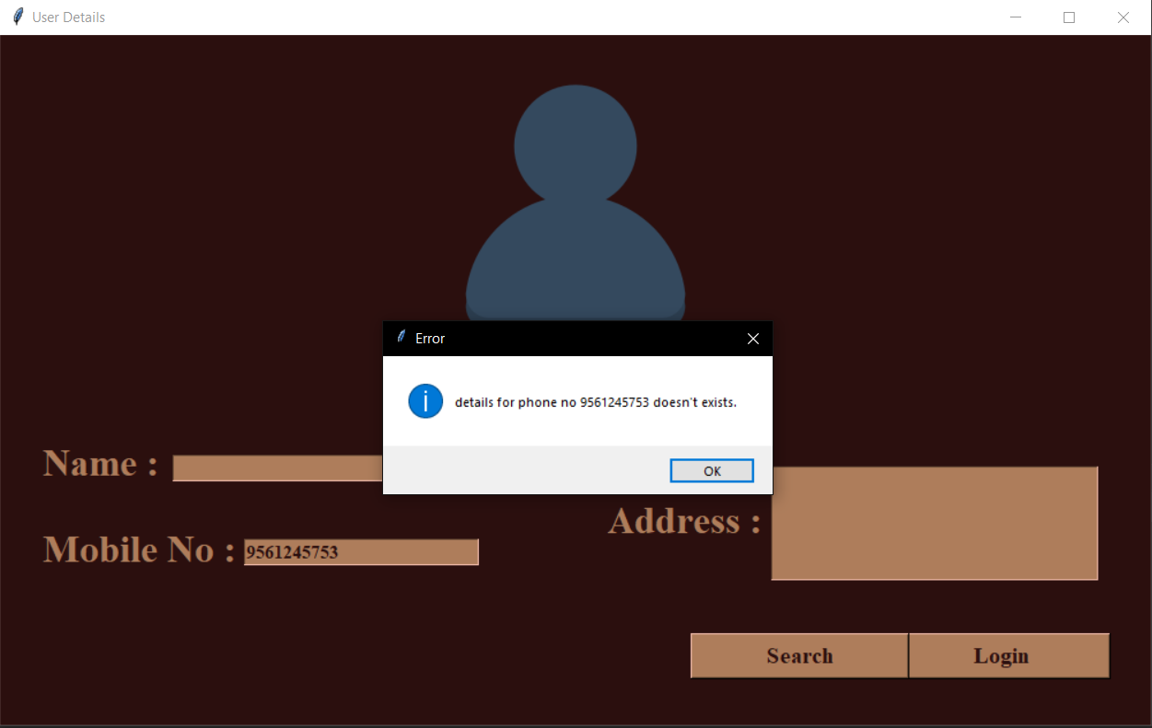
If the user is searching for that phone number which is not register then system will throw the error of data not found
-Dr. Yogita Mane

Slide 21
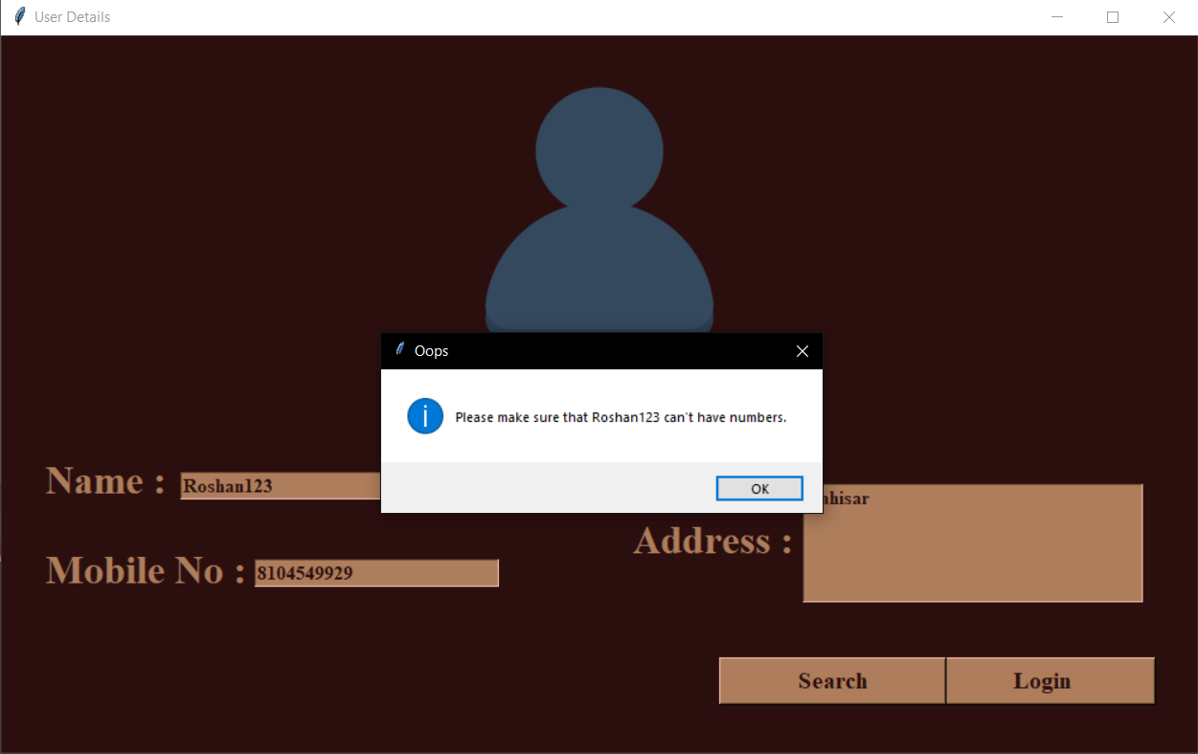
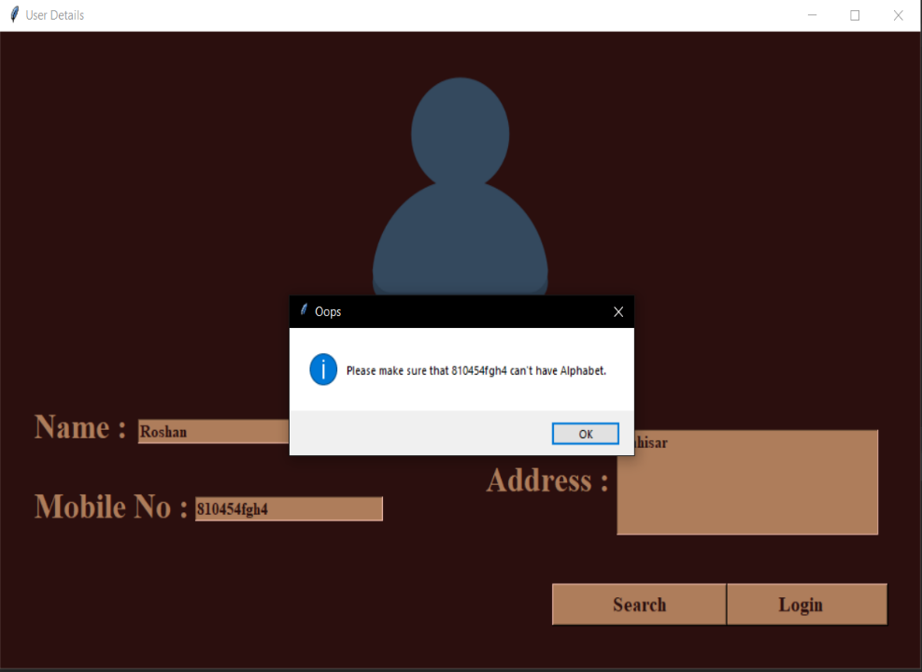
If user has entered any numeric value in name or any alphabet in phone number then system will throw the syntax error.
-Dr. Yogita Mane

Slide 22
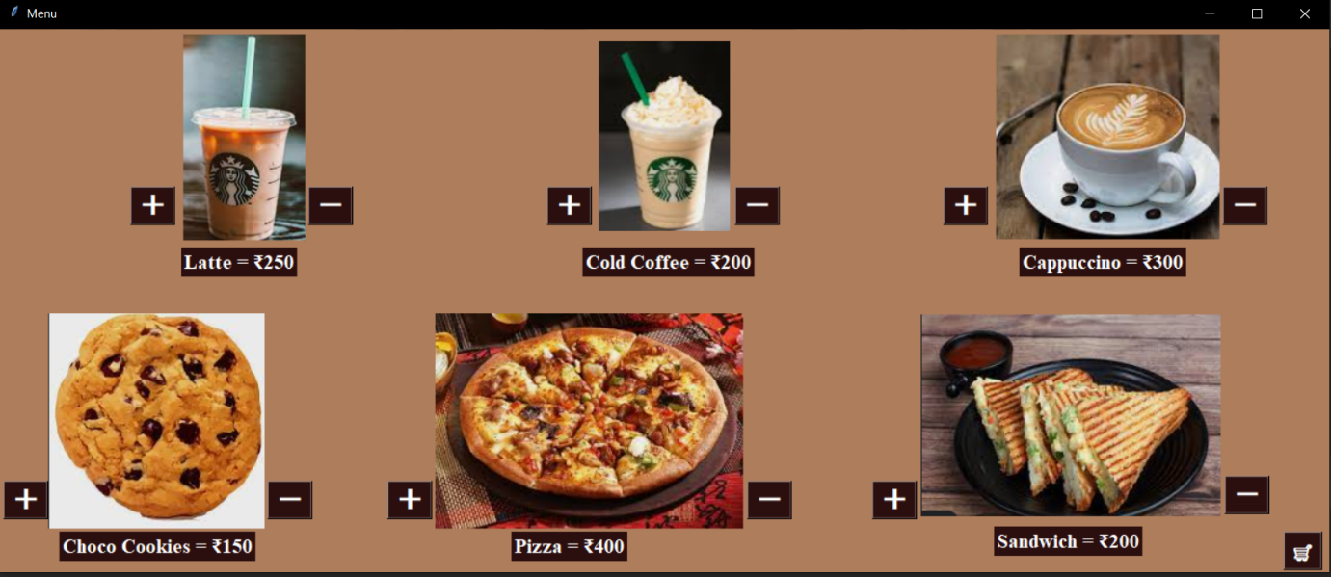
After logging in to the application the user will be address to menu page where he/she will be adding the item to cart
-Dr. Yogita Mane

Slide 23
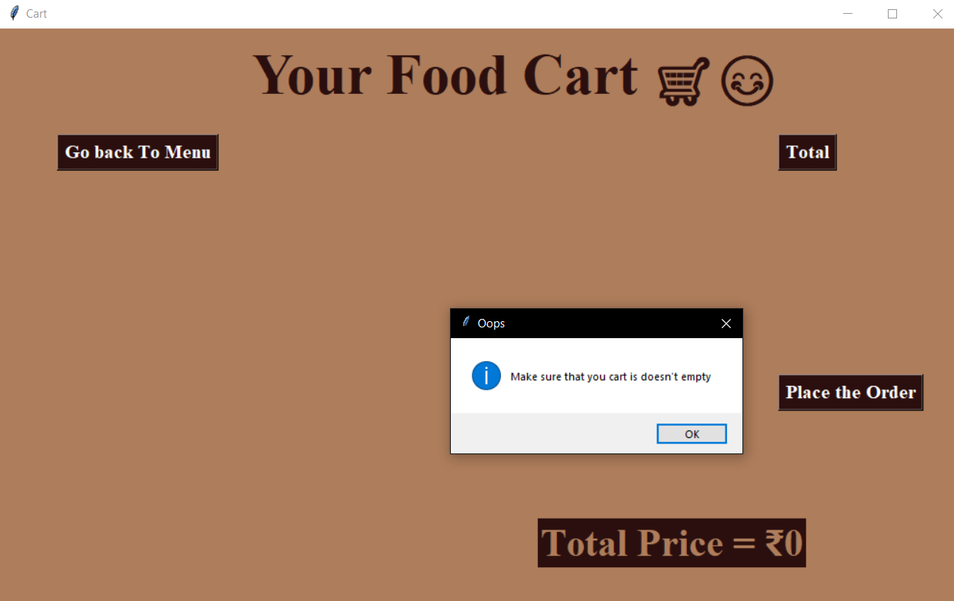
First if you click the cart symbol it will take you to cart where your cart will be empty. If you try to place the order without adding the item, system will give you error of empty cart. So you can go back to menu and add the item in your cart.
-Dr. Yogita Mane

Slide 24
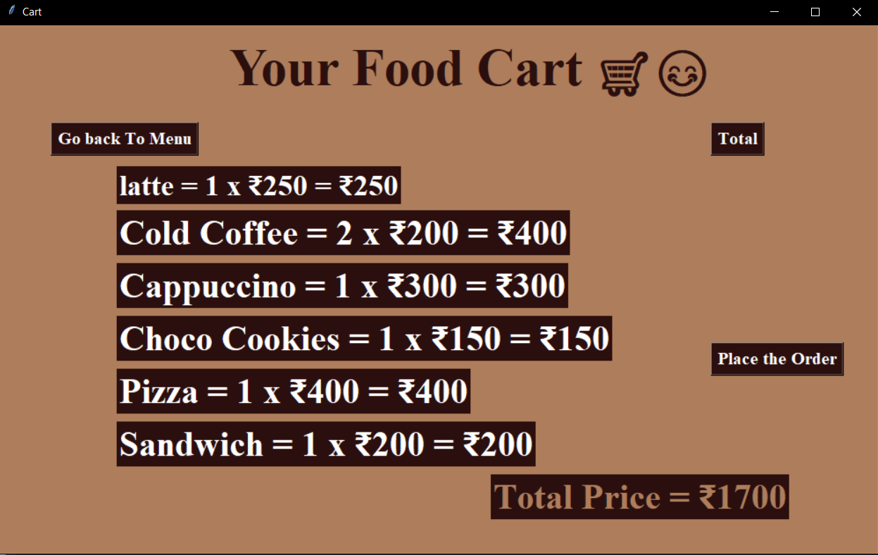
After going back to menu add the items by clicking the plus symbol. And clicking the total button it will give you the total price of your cart. If you have added extra item so you can go back to menu and remove the item from cart.
-Dr. Yogita Mane

Slide 25
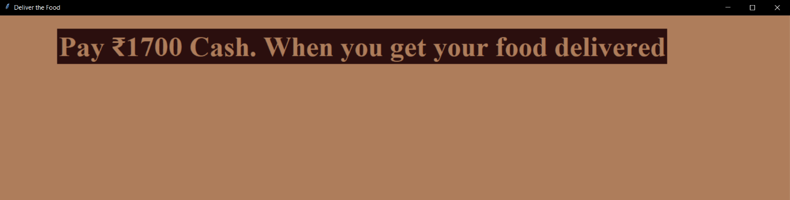
After clicking the place the order button the order will be placed to your address. The payment method is kept only on cash on delivery. The moment you click it will display like this.
-Dr. Yogita Mane

Slide 26
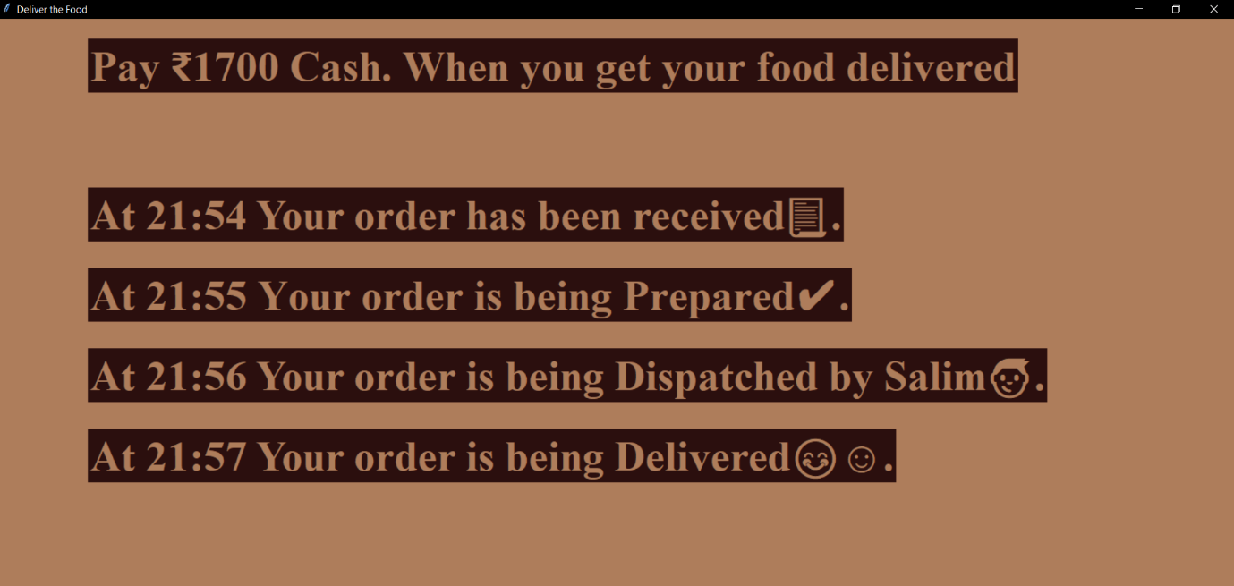
The system will also give you the track of you order. After getting your food you can close the app.
-Dr. Yogita Mane

Slide 27
ANY
SUGGESSTION?
-Dr. Yogita Mane

Slide 28


THANK YOU
-Dr. Yogita Mane

